Slide 1
Employee Data Analysis using Excel
STUDENT NAME:- RUPA KUAMRI.U
REGISTER NO:- 22ca52 (asunm136322ca52)
DEPARTMENT:- B.COM(COMMERCE COMPUTER APPLICATIONS)
COLLEGE:- VALLIAMMAL COLLEGE FOR WOMENS

Slide 2
PROJECT TITLE
salary and compensation analysis through excel data analysis

Slide 3


AGENDA
Problem Statement
Project Overview
End Users
Our Solution and Proposition
Dataset Description
Modelling Approach
Results and Discussion
Conclusion
3/21/2024 Annual Review

Slide 4

PROBLEM STATEMENT
salary analysis of employee data can help businesses in a number of ways
it helps identify pay disparities to achieve fairness internally and in comparison to the industry

Slide 5

PROJECT OVERVIEW
.
this dataset contains information about the salaries of employees at a company.each row represents a different employee,and the columns include information such as name,hra ,da,gross salary,pf and net salary

Slide 6
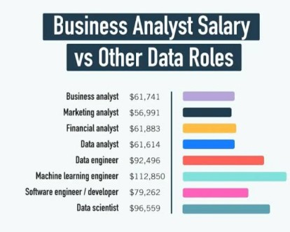

WHO ARE THE END USERS?
1.employee
2.employer
3.worker
all the sectors can be users

Slide 7

OUR SOLUTION AND ITS VALUE PROPOSITION
1.filter-remove
2.formula-hra,da,pf,gross salary,net salary
3.pirot-summary
4.graph-data visulalisation

Slide 8
Dataset Description
1.employee-edunet
2.ememployee id
3.name-type
4.salary
5.hra,da,pf,gr gross salary,net salary

Slide 9

THE "WOW" IN OUR SOLUTION
1.hra=salary*%
2.da=salary*%
3.pf=salary*12%
4.i am prepare garph and Excel by using only an mobile
3/21/2024 Annual Review
9

Slide 10
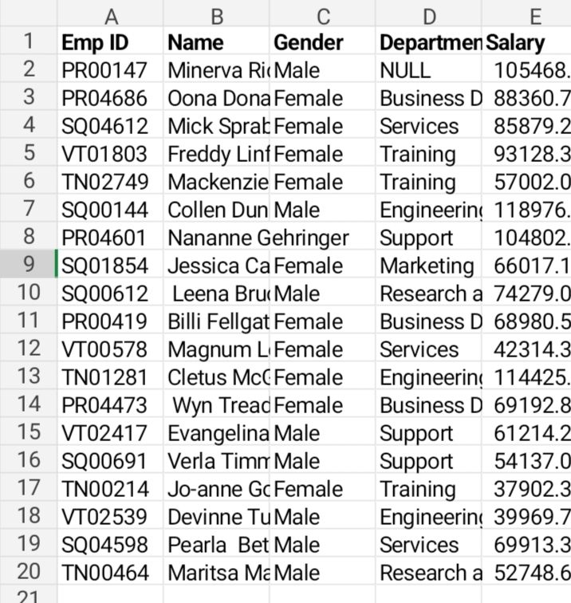
MODELLING
10

Slide 11
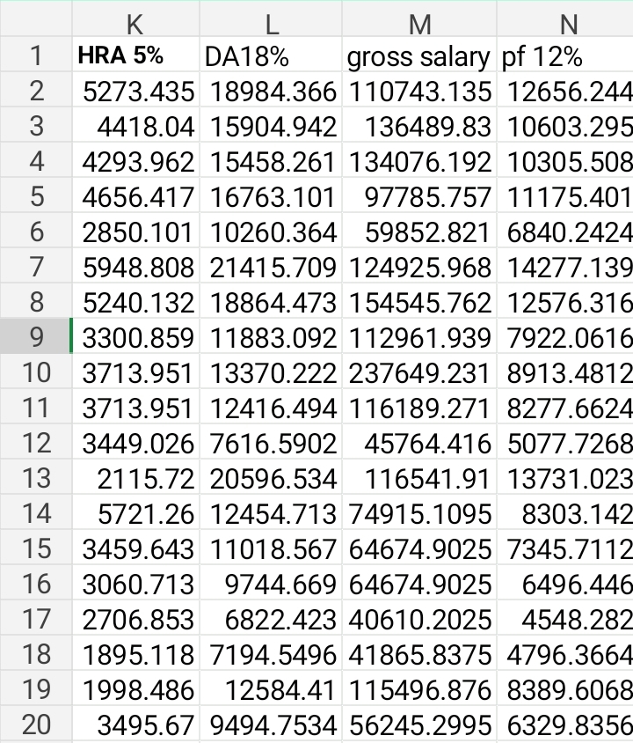
salary and compensation analysis through excel data analysis

Slide 12
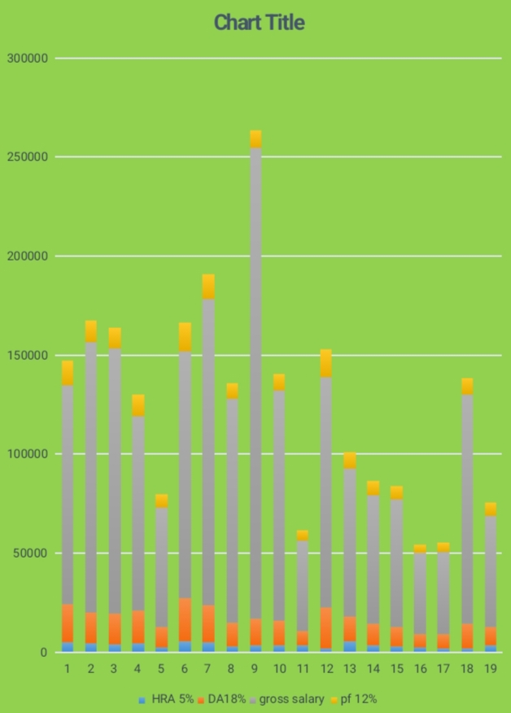
RESULTS
12

Slide 13
conclusion
a salary benchmark helps you organize and summarize your data so you can review situation that need to be employee

